Slide 1


VERSION 2.0 · 2026
CRAXEL 2.0
Brand
guidelines
Logo, colour, gradients, typography, buttons, iconography and imagery.

Slide 2

02
CONTENTS
Logo
01
Versions · clear space · misuse
Colour & gradients
02
7 core colours · 6 gradients
Typography
03
Manrope · DM Mono · scale
Components
04
Buttons · surfaces · iconography
Imagery
05
Subjects · treatment

Slide 3

SECTION 01
Logo

Slide 4

LOGO · VERSIONS
04
Two versions. Always on a solid or scrimmed field.
WHITE · ON NAVY & PHOTO
craxel-logo-white.png
NAVY · ON WHITE & ICE
craxel-logo-navy.png

Slide 5
LOGO · CLEAR SPACE & SIZE
05
MINIMUM SIZE
X
120 px
25 mm
Screen
Print
PLACEMENT
X
Top-left on web, slides and reports. Centred only on covers, merch and the closing slide.
X = height of the “C” in the wordmark. Keep X clear on all four sides.

Slide 6
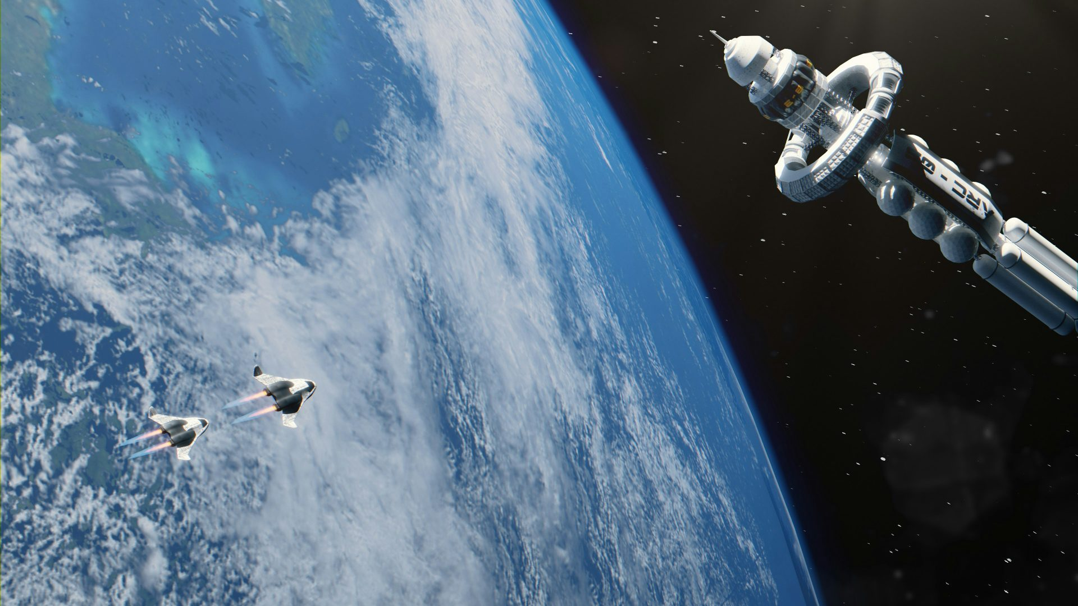
LOGO · DON’T
06
Don’t stretch or squash
Don’t rotate
Don’t recolour
Don’t add effects or shadows
Don’t use on low-contrast fields
Don’t place on photos without a scrim

Slide 7
SECTION 02
Colour &
gradients

Slide 8
COLOUR · CORE PALETTE
08
Navy leads. Blue acts. Coral alerts.
Mist
Ice
Coral
Navy 900
Slate
Blue 600
Blue 400
#DCE8F0
#D9ECFA
#E5646A
#080B1A
#4B5A7A
#2597DA
#38B6FF
220 232 240
217 236 250
229 100 106
RGB 8 11 26
75 90 122
37 151 218
56 182 255

Slide 9
COLOUR · USAGE
09
PROPORTION
NAVY 55%
MIST · ICE · WHITE 25%
SLATE
TEXT ON LIGHT
TEXT ON NAVY
RULES
Navy 900 · headings, body
White · headings, body
Blue is for actions, eyebrow squares and data highlights. Never set body or headline text in light blue. Coral is reserved for alerts and critical data points.
Slate · secondary
#C8D3E3 · secondary

Slide 10
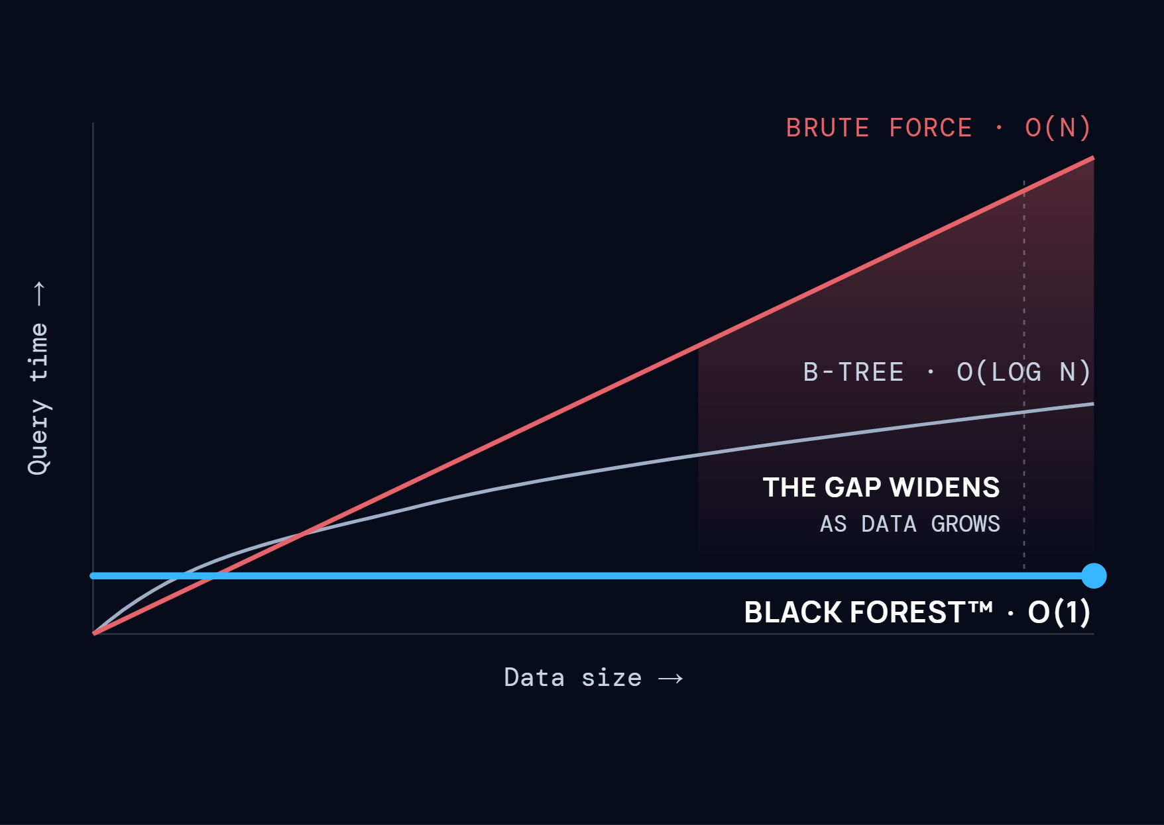

COLOUR · IN DATA
10
Blue is always Black Forest.
THE BREAKTHROUGH
QUERY TIME VS DATA SIZE
Hero series · Black Forest
#38B6FF · 6px · glow 12px
Comparison · brute force
#E5646A · 4px
Baseline · other methods
#9FB0C6 · 3px
Gap area
#E5646A 32% → 0% · 180°
The address of a record is computed, not searched for. Ten thousand records or ten billion, the clock reads the same.
Axes & gridlines
#FFFFFF 16% on navy · DM Mono labels

Slide 11





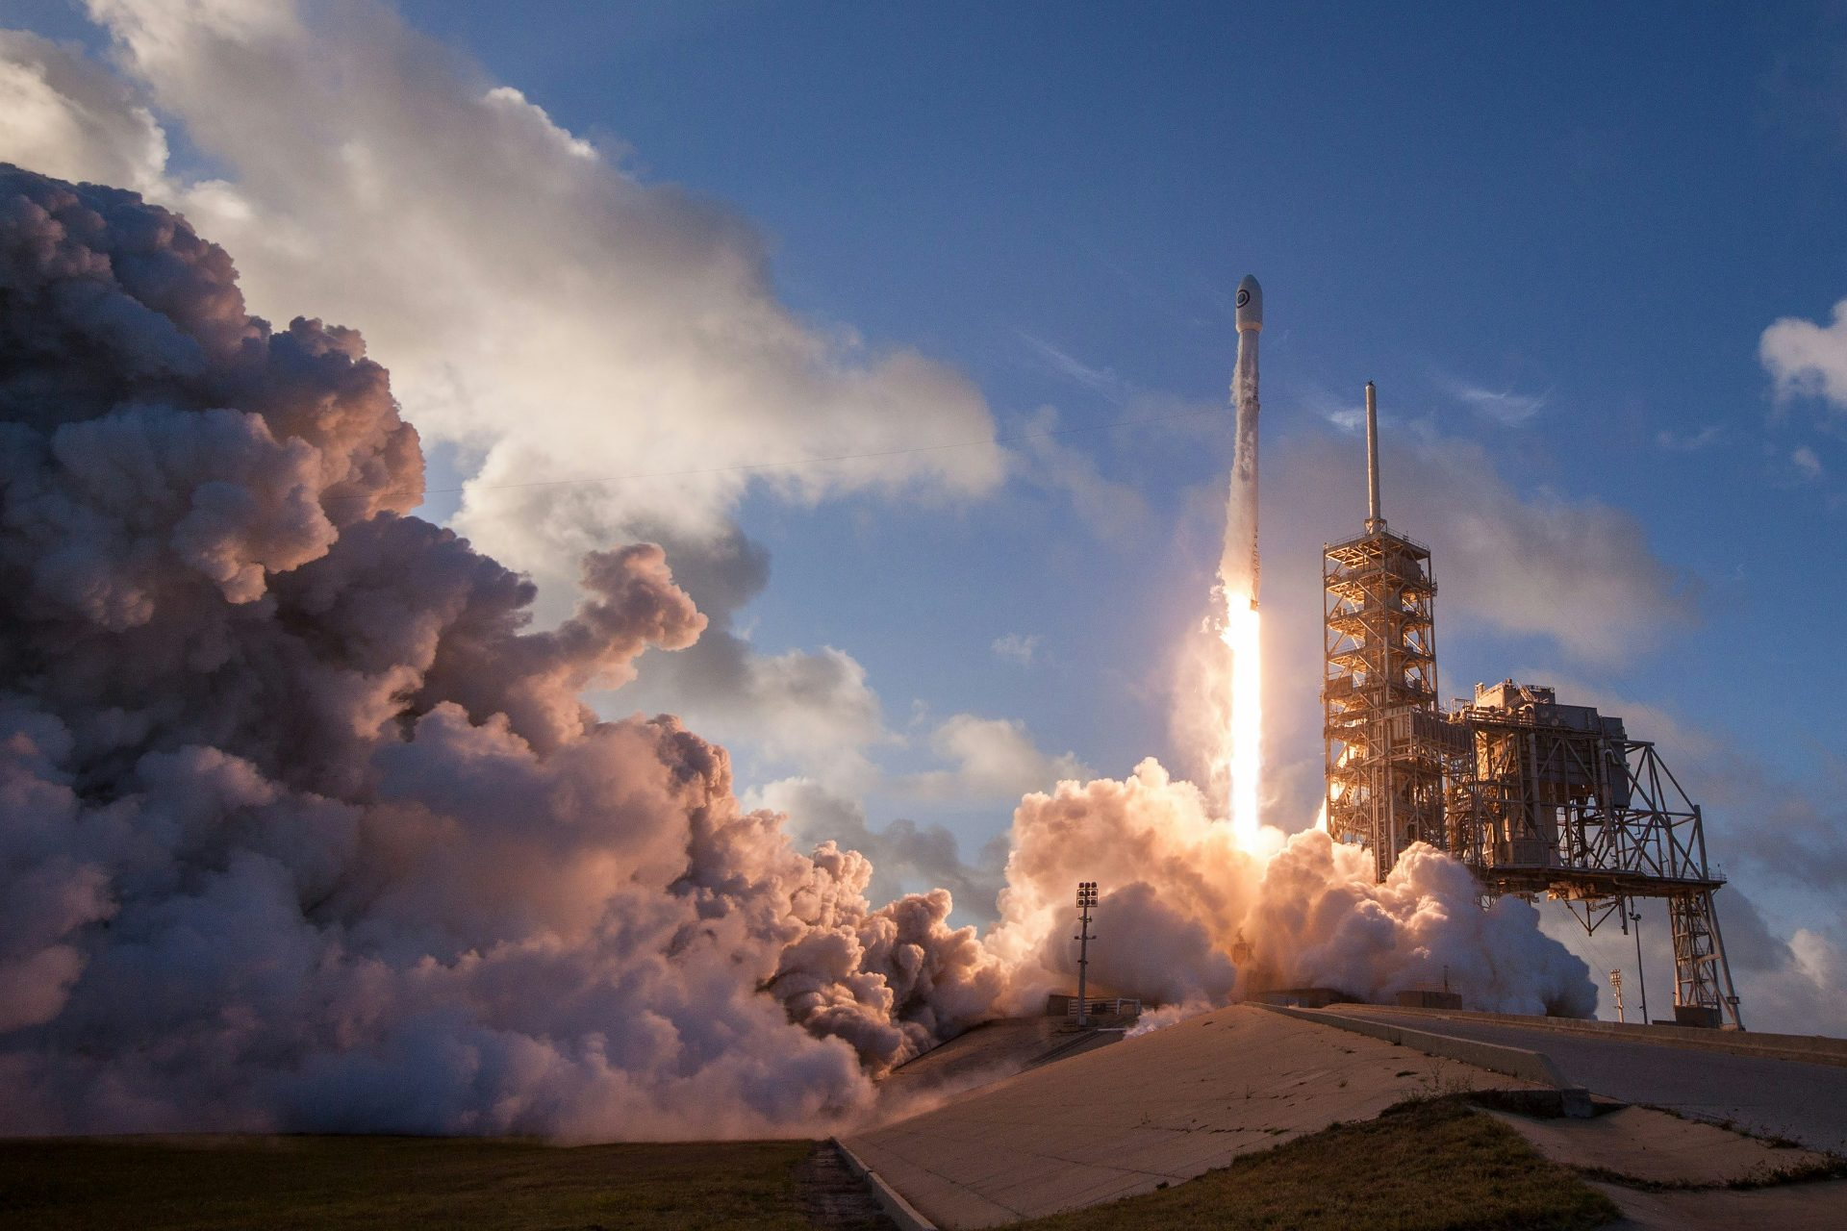

GRADIENTS · DARK SURFACES
11
Horizon glow
RADIAL · 65% 100%
Corner glow
RADIAL · 100% 0%
Navy depth
LINEAR · 180°
#38B6FF
100% · 0%
#38B6FF
60% · 0%
#2597DA
35% · 45%
#2597DA
0% · 75%
#0E1121
100% · 0%
#080B1A
100% · 80%
#080B1A
100% · base
#080B1A
100% · 100%
Photo scrim
LINEAR · 180°
Glass panel
LINEAR · 180° · BLUR 20
#080B1A
40% · 0%
#FFFFFF
14% · 0%
#080B1A
0% · 30%
#FFFFFF
4% · 100%
#080B1A
90% · 100%

Slide 12




GRADIENTS · LIGHT SURFACES
12
Ice fade
LINEAR · 180°
Ice deep
LINEAR · 180°
Mist wash
LINEAR · 180°
#FFFFFF
100% · 0%
#FFFFFF
100% · 0%
#F4F8FC
100% · 0%
#EAF5FE
100% · 100%
#D9ECFA
100% · 100%
#DCE8F0
100% · 100%
RULES
Light corner glow
RADIAL · 100% 0%
Light horizon
RADIAL · 65% 100%
Gradients only mix the core palette. Use one glow per surface. Light gradients sit behind navy text only.
#38B6FF
35% · 0%
#2597DA
45% · 0%
#38B6FF
0% · 75%
#38B6FF
18% · 45%
#FFFFFF
100% · base
#FFFFFF
100% · base

Slide 13
SECTION 03
Typography

Slide 14
TYPEFACES
14
PRIMARY · HEADLINES & BODY
SECONDARY · EYEBROWS, DATA, LABELS
Aa
Aa
Manrope
Regular
Medium
SemiBold
Bold
DM Mono
ABCDEFGHIJKLMNOPQRSTUVWXYZ abcdefghijklmnopqrstuvwxyz 0123456789
Regular
Medium
UPPERCASE · TRACKING +16%

Slide 15
TYPE SCALE · WEB DESKTOP
15
Constant time
DISPLAY
Bold 96 / 0.9 / −5%
Simplify the complexity
H1
Bold 64 / 1.0 / −4%
H2
Four things Black Forest does differently
SemiBold 40 / 1.1 / −3%
BODY
Black Forest indexes data on arrival and returns results in constant time, at any scale.
Regular 20 / 1.5 / 0
EYEBROW
SPACE & DEFENCE
Plex Mono 13 / +16%

Slide 16
SECTION 04
Components

Slide 17
BUTTONS & CONTROLS
17
ON DARK
ON LIGHT
DISCOVER BLACK FOREST™
Primary
Get in touch
Read more
Request a demo
Primary
Case study
Explore the sector
All solutions
All
Blogs
News
Reports
Explore the sector
Solutions
Company
sales@craxel.com
SOLUTIONS
CAROUSEL · PAGINATION
One primary button per screen. Secondary actions are outlined or plain text links with an arrow. Tags and labels are plain mono text, not pills.
Ink button is primary on light. Filter tabs use line icons with an underline on the active item. Text links are #2597DA with a trailing arrow.

Slide 18
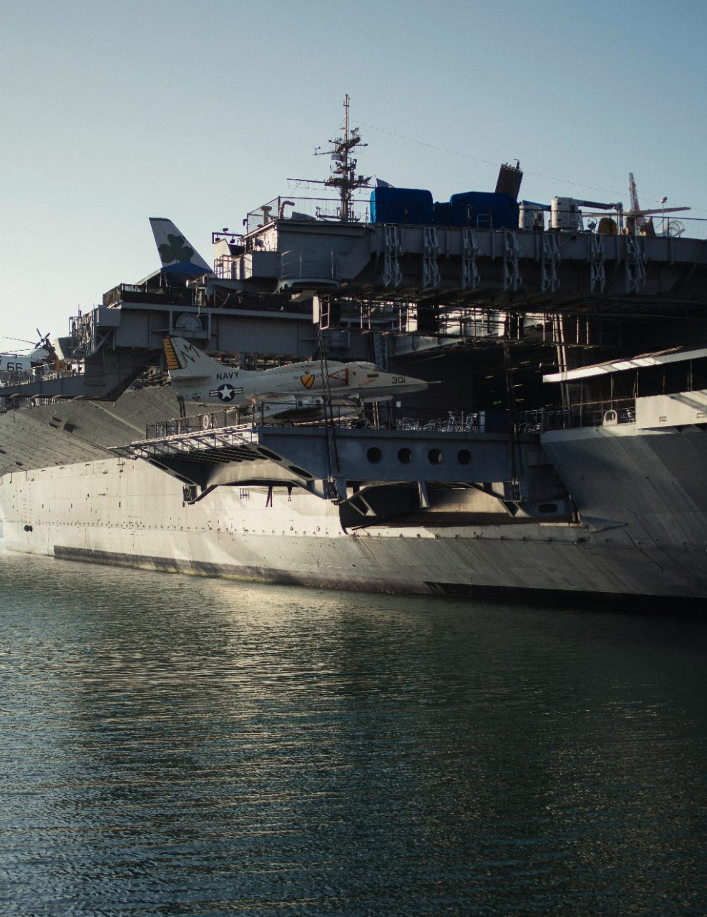

SURFACES & EYEBROWS
18
PLATFORM
HIGHLIGHT
DEFENCE
Glass over photo
Indexed on arrival
Constant-time index
Light card
Feature card
Glass panel
#F4F8FC · 1px #080B1A 8% · r24
Corner glow · one per group
Lighter top, clearer base · blur 20

Slide 19
ICONOGRAPHY
19
Line icons. 24 grid, 1.5 stroke, square caps.
Search
Encryption
Data
Geospatial
Navy on light, white on dark. Use a Blue 600 tile only for a single featured icon. No fills, no duotone.
Defence
Platform
Analytics
Action

Slide 20

SECTION 05
Imagery

Slide 21
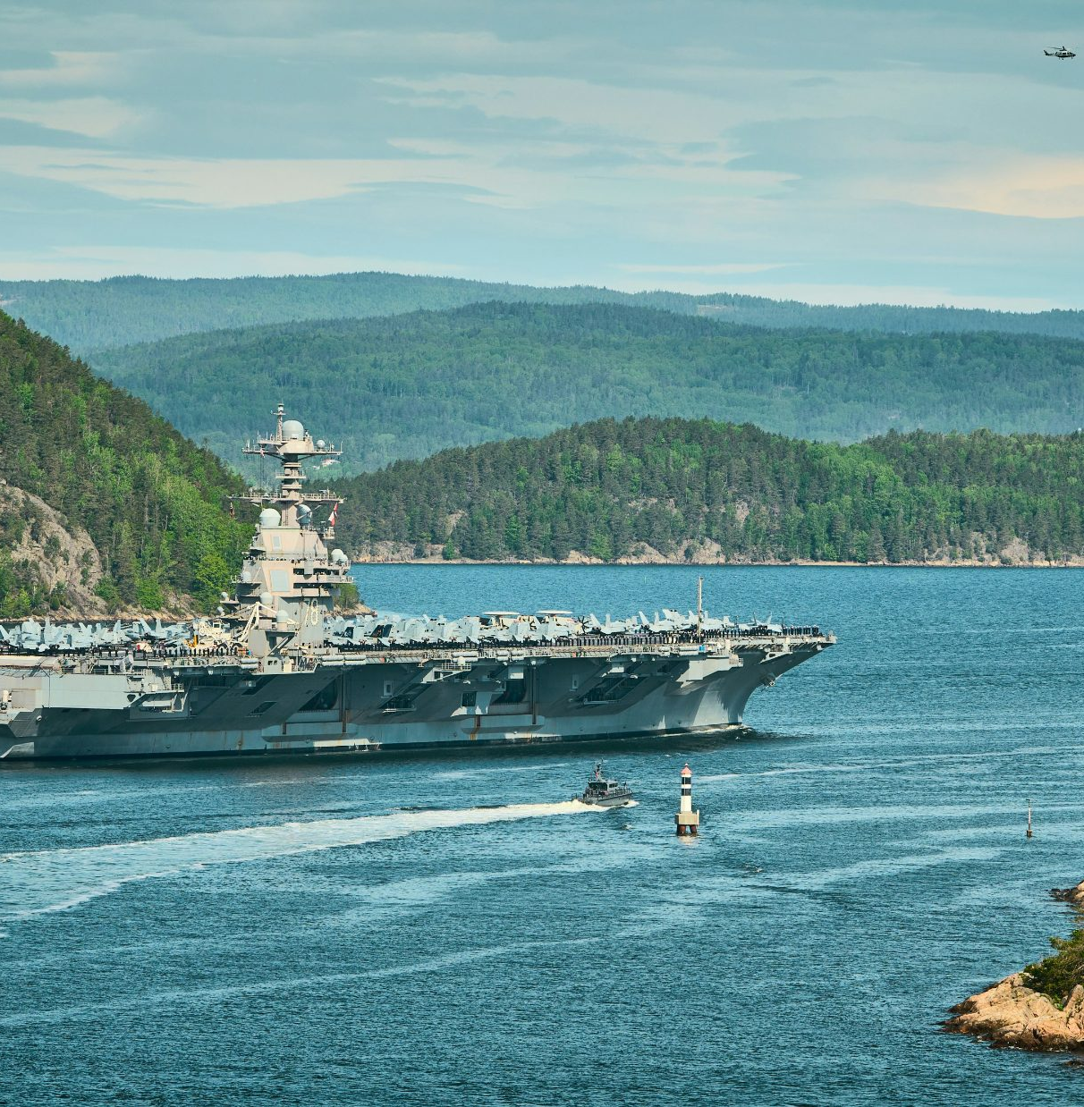


IMAGERY · ONE TREATMENT
21
Real missions, cool light, navy scrim.
DEFENCE
SPACE
ENTERPRISE
Platforms and people on mission. No staged stock poses.
Orbit and launch. Blue glow rises from the base.
Data and infrastructure. Cool, low-saturation tones.
SCRIM · #080B1A 40% → 0% at 30% → 90% · 180° · GLOW · #38B6FF 45% radial from base

Slide 22

BRAND QUESTIONS · MARKETING@CRAXEL.COM

